Slide 1

Bioinformatics Bootcamp
Special Topic Workshop: “Single Cell RNA-Seq Analysis”
Module 3: Uncovering dataset structure

Slide 2
scRNA-Seq Downstream Analysis Workflow
Load Data
QC
Normalize & Scale
PCA & Nearest Neighbor Graph
Clustering
Advanced:
Cluster Marker Analysis
Cell Type Identification
Sub-clustering
Trajectories
Cell Cycle Analysis
Cluster DGE
Low Dimensional Embedding

Slide 3
scRNA-Seq Downstream Analysis Workflow
Load Data
QC
Normalize & Scale
PCA & Nearest Neighbor Graph
Clustering
Advanced:
Cluster Marker Analysis
Cell Type Identification
Sub-clustering
Trajectories
Cell Cycle Analysis
Cluster DGE
Low Dimensional Embedding

Slide 4
scRNA-Seq Downstream Analysis Workflow
Load Data
QC
Normalize & Scale
PCA & Nearest Neighbor Graph
Clustering
Advanced:
Cluster Marker Analysis
Cell Type Identification
Sub-clustering
Trajectories
Cell Cycle Analysis
Cluster DGE
Low Dimensional Embedding

Slide 5
scRNA-Seq Downstream Analysis Workflow
Load Data
QC
Normalize & Scale
PCA & Nearest Neighbor Graph
Clustering
Advanced:
Cluster Marker Analysis
Cell Type Identification
Sub-clustering
Trajectories
Cell Cycle Analysis
Cluster DGE
Low Dimensional Embedding

Slide 6
Recap: Handling Zero Inflation in scRNA-Seq

Slide 7
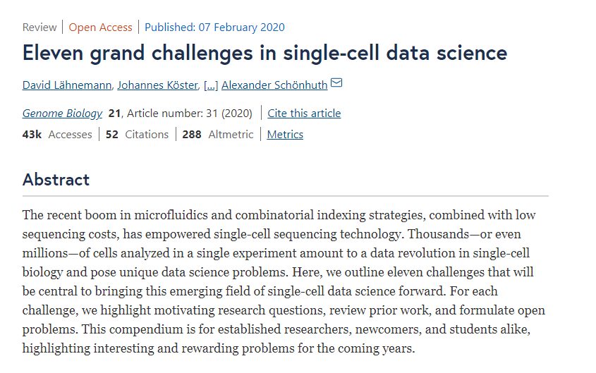

Slide 8
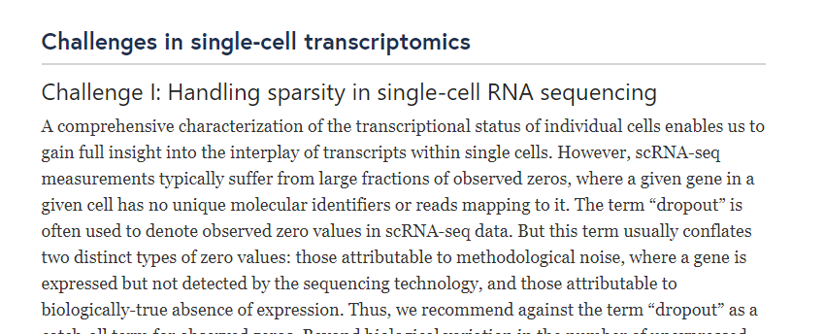

Slide 9
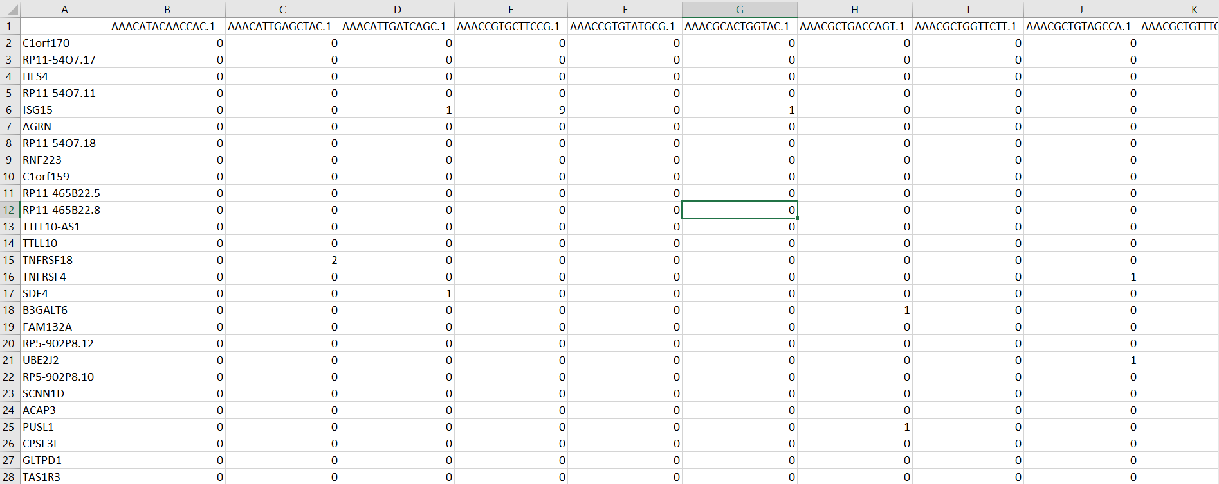
The Challenge of Sparsity

Slide 10
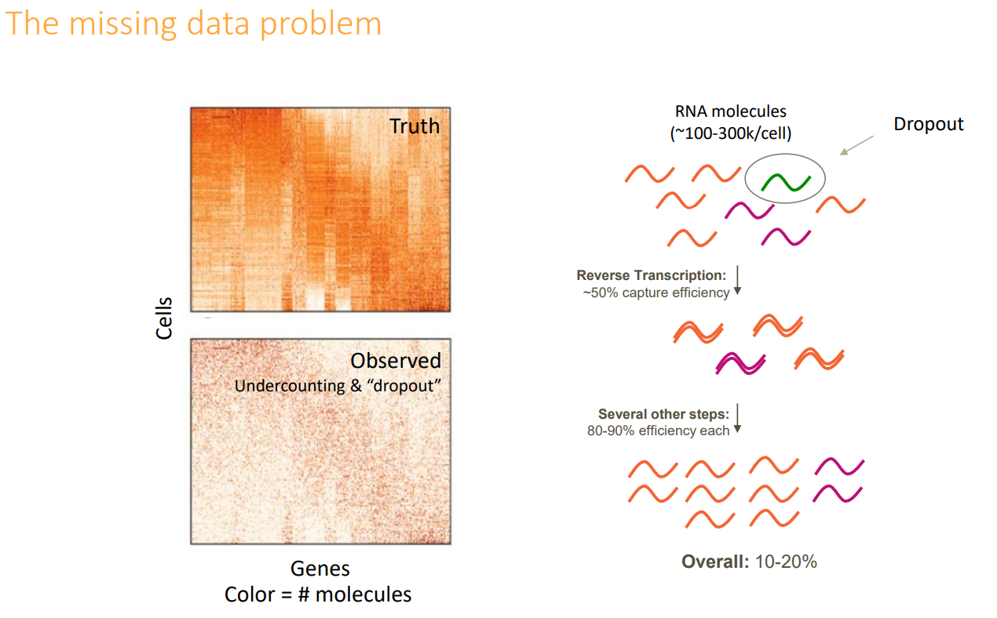
https://www.slideshare.net/insideHPC/singlecell-sequencing-for-drug-discovery-applications-and-challenges?from_action=save

Slide 11
https://www.slideshare.net/insideHPC/singlecell-sequencing-for-drug-discovery-applications-and-challenges?from_action=save

Slide 12
How to handle Zero-Inflation?
Use a statistical framework which is robust against zero inflation
Impute missing UMI count values

Slide 13
How to handle Zero-Inflation?
Use a statistical framework which is robust against zero inflation
Impute missing UMI count values

Slide 14
Seurat pipeline for mitigating Zero-inflation
Load Data
QC
Normalize & Scale
PCA & Nearest Neighbor Graph
Clustering
Advanced:
Cluster Marker Analysis
Cell Type Identification
Sub-clustering
Trajectories
Cell Cycle Analysis
Cluster DGE
Low Dimensional Embedding

Slide 15
Seurat pipeline for mitigating Zero-inflation
Load Data
QC
Normalize & Scale
PCA & Nearest Neighbor Graph
Clustering
Advanced:
Cluster Marker Analysis
Cell Type Identification
Sub-clustering
Trajectories
Cell Cycle Analysis
Cluster DGE
Low Dimensional Embedding

Slide 16
Seurat pipeline for mitigating Zero-inflation
Load Data
QC
Normalize & Scale
PCA & Nearest Neighbor Graph
Clustering
Advanced:
Cluster Marker Analysis
Cell Type Identification
Sub-clustering
Trajectories
Cell Cycle Analysis
Cluster DGE
Low Dimensional Embedding
Filter low quality cells
Log2(x+1) transform
Find Variable Features
Center and scale variable features
Run PCA and select informative dimensions

Slide 17
Seurat pipeline for mitigating Zero-inflation
Load Data
QC
Normalize & Scale
PCA & Nearest Neighbor Graph
Clustering
Advanced:
Cluster Marker Analysis
Cell Type Identification
Sub-clustering
Trajectories
Cell Cycle Analysis
Cluster DGE
Low Dimensional Embedding
Filter low quality cells
Log2(x+1) transform
Find Variable Features
Center and scale variable features
Run PCA and select informative dimensions

Slide 18
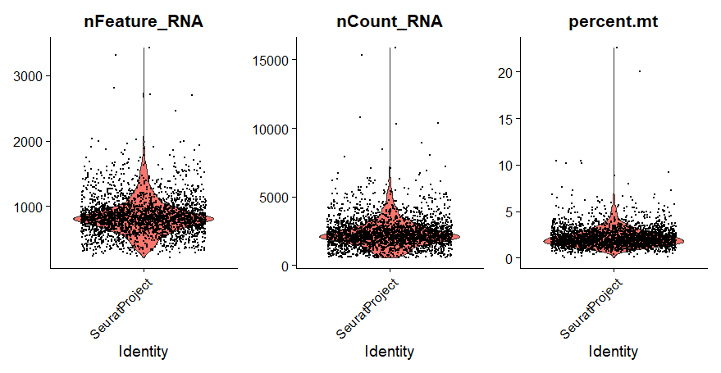
Seurat pipeline for mitigating Zero-inflation
Load Data
QC
Normalize & Scale
PCA & Nearest Neighbor Graph
Clustering
Advanced:
Cluster Marker Analysis
Cell Type Identification
Sub-clustering
Trajectories
Cell Cycle Analysis
Cluster DGE
Low Dimensional Embedding
Filter low quality cells
Log2(x+1) transform
Find Variable Features
Center and scale variable features
Run PCA and select informative dimensions

Slide 19
Seurat pipeline for mitigating Zero-inflation
Load Data
QC
Normalize & Scale
PCA & Nearest Neighbor Graph
Clustering
Advanced:
Cluster Marker Analysis
Cell Type Identification
Sub-clustering
Trajectories
Cell Cycle Analysis
Cluster DGE
Low Dimensional Embedding
Filter low quality cells
Log2(x+1) transform
Find Variable Features
Center and scale variable features
Run PCA and select informative dimensions

Slide 20
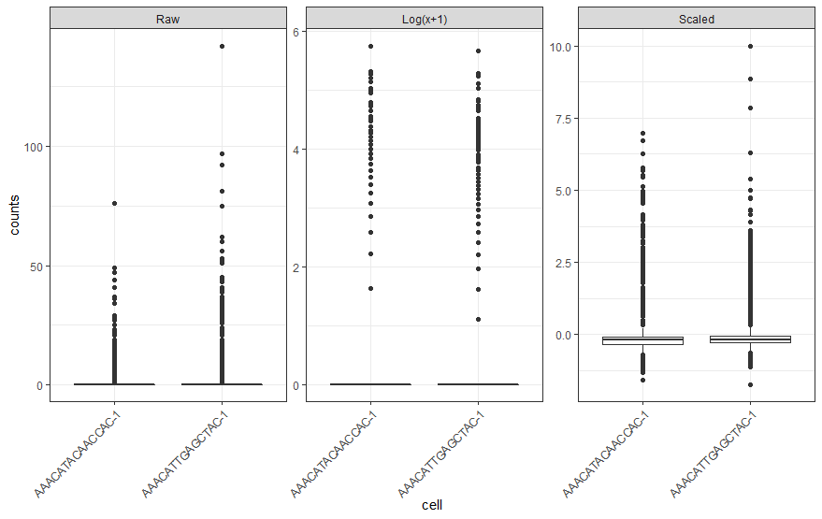
Seurat pipeline for mitigating Zero-inflation
Load Data
QC
Normalize & Scale
PCA & Nearest Neighbor Graph
Clustering
Advanced:
Cluster Marker Analysis
Cell Type Identification
Sub-clustering
Trajectories
Cell Cycle Analysis
Cluster DGE
Low Dimensional Embedding
Filter low quality cells
Log2(x+1) transform
Find Variable Features
Center and scale variable features
Run PCA and select informative dimensions

Slide 21
Seurat pipeline for mitigating Zero-inflation
Load Data
QC
Normalize & Scale
PCA & Nearest Neighbor Graph
Clustering
Advanced:
Cluster Marker Analysis
Cell Type Identification
Sub-clustering
Trajectories
Cell Cycle Analysis
Cluster DGE
Low Dimensional Embedding
Filter low quality cells
Log2(x+1) transform
Find Variable Features
Center and scale variable features
Run PCA and select informative dimensions

Slide 22
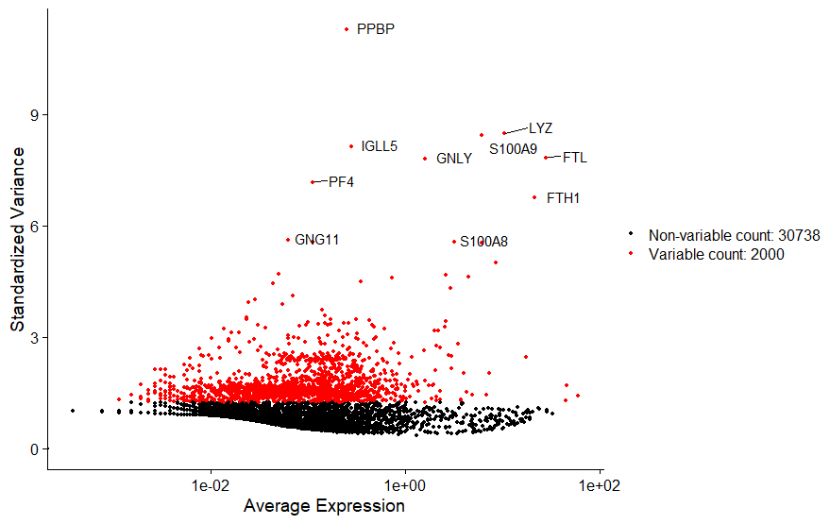
Seurat pipeline for mitigating Zero-inflation
Load Data
QC
Normalize & Scale
PCA & Nearest Neighbor Graph
Clustering
Advanced:
Cluster Marker Analysis
Cell Type Identification
Sub-clustering
Trajectories
Cell Cycle Analysis
Cluster DGE
Low Dimensional Embedding
Filter low quality cells
Log2(x+1) transform
Find Variable Features
Center and scale variable features
Run PCA and select informative dimensions

Slide 23
Seurat pipeline for mitigating Zero-inflation
Load Data
QC
Normalize & Scale
PCA & Nearest Neighbor Graph
Clustering
Advanced:
Cluster Marker Analysis
Cell Type Identification
Sub-clustering
Trajectories
Cell Cycle Analysis
Cluster DGE
Low Dimensional Embedding
Filter low quality cells
Log2(x+1) transform
Find Variable Features
Center and scale variable features
Run PCA and select informative dimensions

Slide 24
Seurat pipeline for mitigating Zero-inflation
Load Data
QC
Normalize & Scale
PCA & Nearest Neighbor Graph
Clustering
Advanced:
Cluster Marker Analysis
Cell Type Identification
Sub-clustering
Trajectories
Cell Cycle Analysis
Cluster DGE
Low Dimensional Embedding
Filter low quality cells
Log2(x+1) transform
Find Variable Features
Center and scale variable features
Run PCA and select informative dimensions

Slide 25
Seurat pipeline for mitigating Zero-inflation
Load Data
QC
Normalize & Scale
PCA & Nearest Neighbor Graph
Clustering
Advanced:
Cluster Marker Analysis
Cell Type Identification
Sub-clustering
Trajectories
Cell Cycle Analysis
Cluster DGE
Low Dimensional Embedding
Filter low quality cells
Log2(x+1) transform
Find Variable Features
Center and scale variable features
Run PCA and select informative dimensions

Slide 26
PCA: why and how?

Slide 27
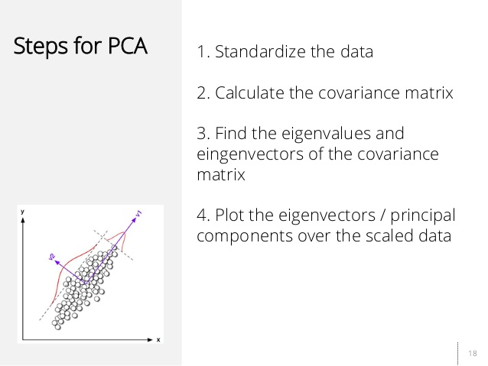
https://image.slidesharecdn.com/principalcomponentanalysis-130916163816-phpapp01/95/principal-component-analysis-18-638.jpg?cb=1379350085

Slide 28
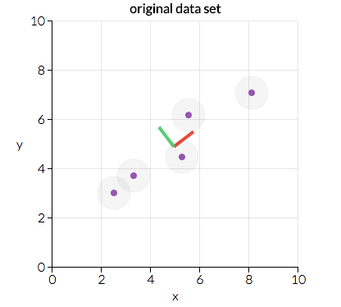
https://setosa.io/ev/principal-component-analysis/

Slide 29
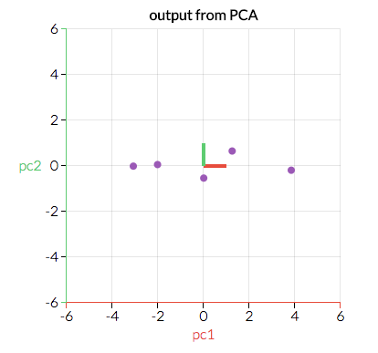
https://setosa.io/ev/principal-component-analysis/

Slide 30
scRNA-Seq Downstream Analysis Workflow
Load Data
QC
Normalize & Scale
PCA & Nearest Neighbor Graph
Clustering
Advanced:
Cluster Marker Analysis
Cell Type Identification
Sub-clustering
Trajectories
Cell Cycle Analysis
Cluster DGE
Low Dimensional Embedding

Slide 31
scRNA-Seq Downstream Analysis Workflow
Load Data
QC
Normalize & Scale
PCA & Nearest Neighbor Graph
Clustering
Advanced:
Cluster Marker Analysis
Cell Type Identification
Sub-clustering
Trajectories
Cell Cycle Analysis
Cluster DGE
Low Dimensional Embedding
Download/pull the GitHub repo and open the module_3.Rproj file

Slide 32
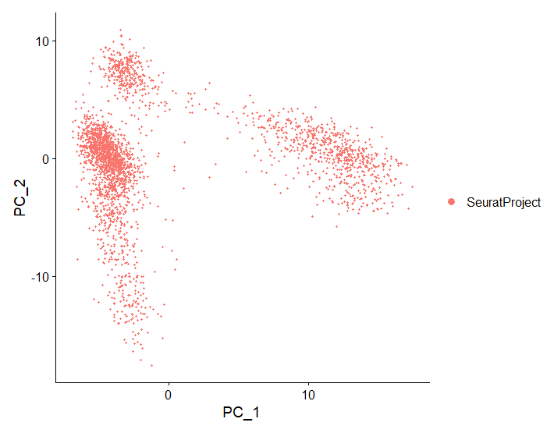

Slide 33
scRNA-Seq Downstream Analysis Workflow
Load Data
QC
Normalize & Scale
PCA & Nearest Neighbor Graph
Clustering
Advanced:
Cluster Marker Analysis
Cell Type Identification
Sub-clustering
Trajectories
Cell Cycle Analysis
Cluster DGE
Low Dimensional Embedding

Slide 34
scRNA-Seq Downstream Analysis Workflow
Load Data
QC
Normalize & Scale
PCA & Nearest Neighbor Graph
Clustering
Advanced:
Cluster Marker Analysis
Cell Type Identification
Sub-clustering
Trajectories
Cell Cycle Analysis
Cluster DGE
Low Dimensional Embedding

Slide 35
Biological graphs, Nearest Neighbors

Slide 36
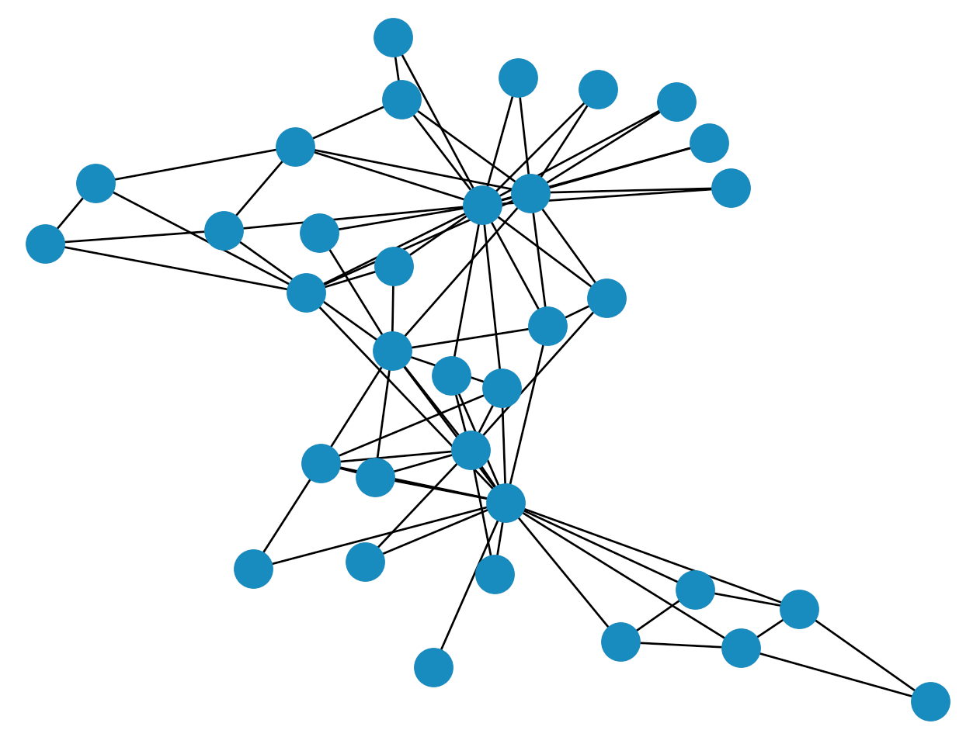
https://pennylane.ai/qml/demos/qgrnn.html

Slide 37
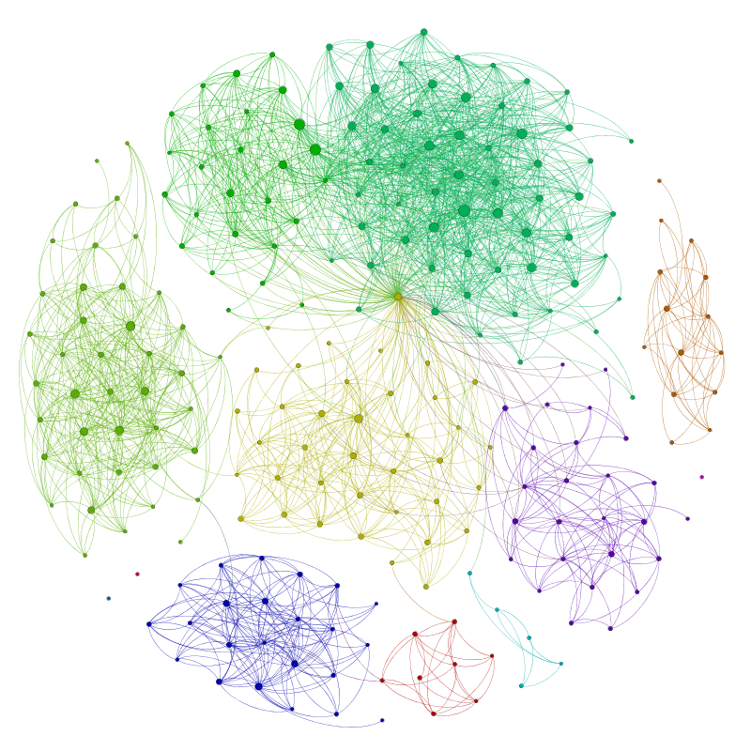
http://allthingsgraphed.com/2014/08/28/facebook-friends-network/

Slide 38
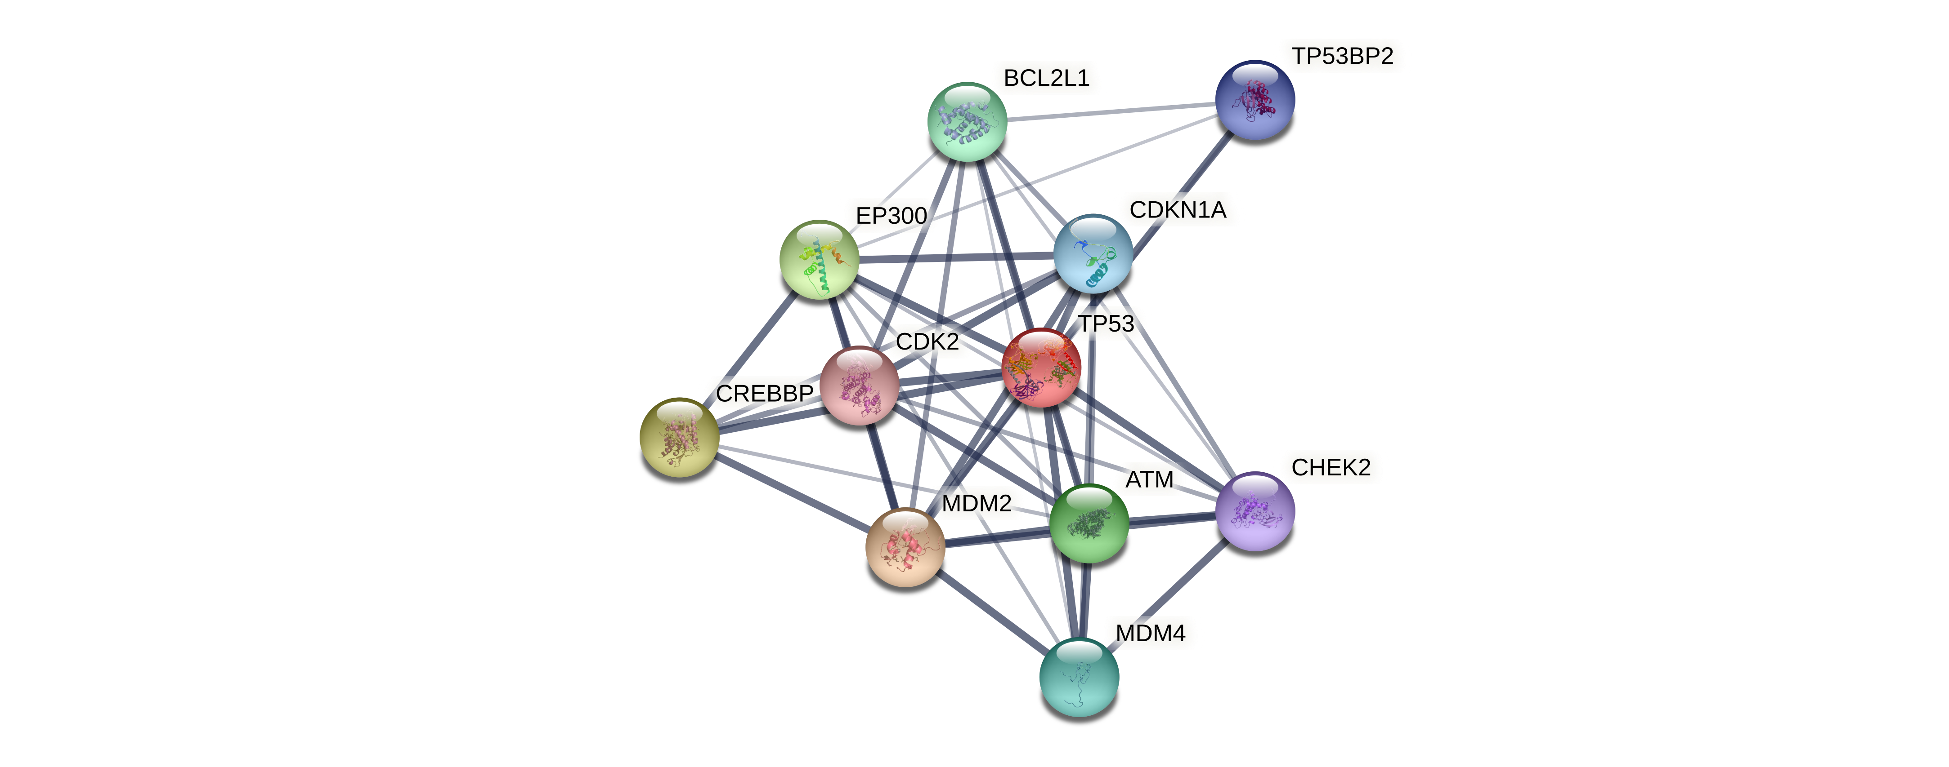
https://string-db.org/cgi/network?taskId=bShG038r1ivx&sessionId=bVWWSaTdebeB

Slide 39
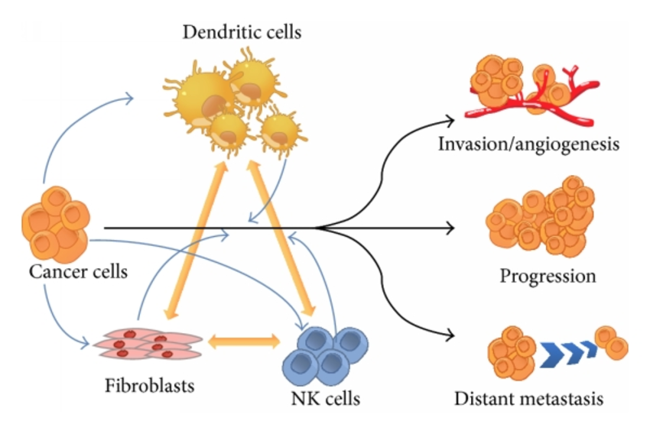
https://www.researchgate.net/figure/Cell-cell-interactions-in-the-tumor-microenvironment-contribute-to-cancer-cell_fig1_270670636

Slide 40
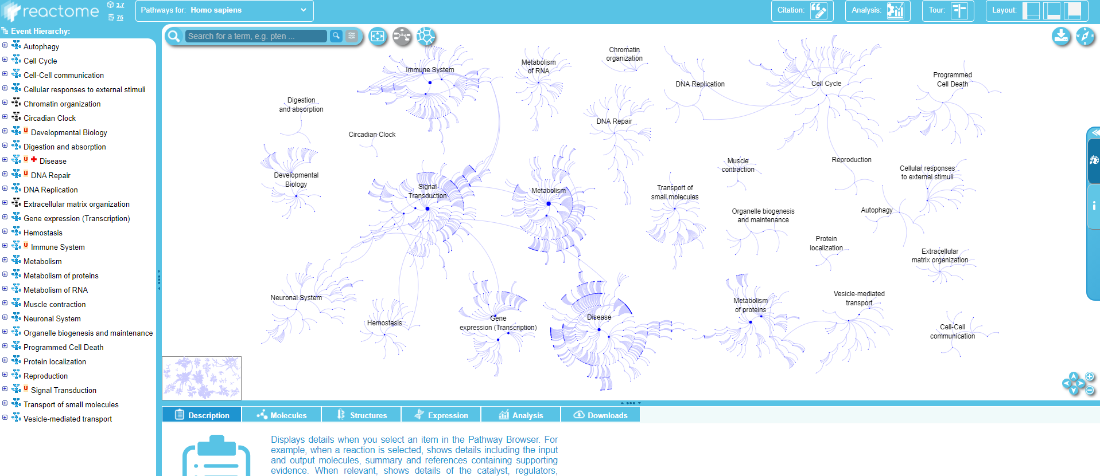

Slide 41
The point of biological research is to reveal the biology graph

Slide 43
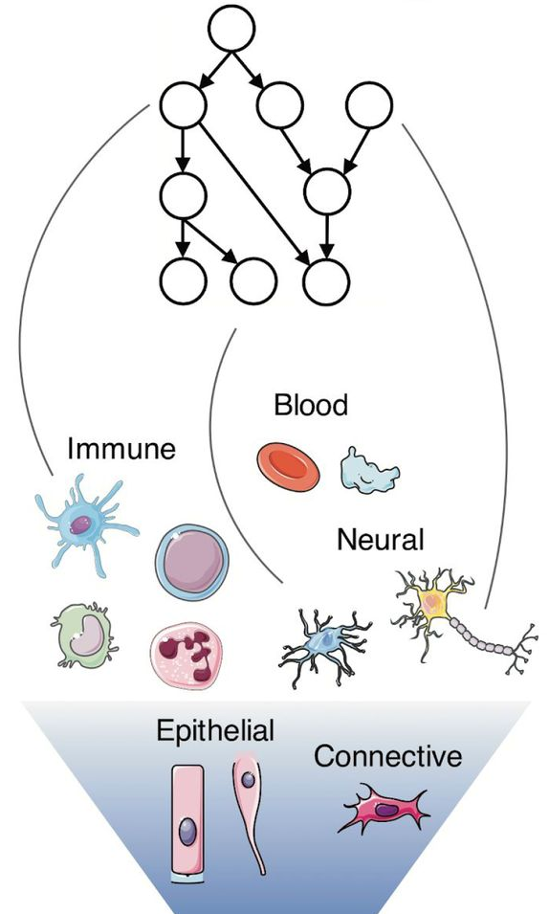
https://www.biorxiv.org/content/10.1101/634097v2.full

Slide 44
How do we construct a graph for something like scRNA-Seq?

Slide 45
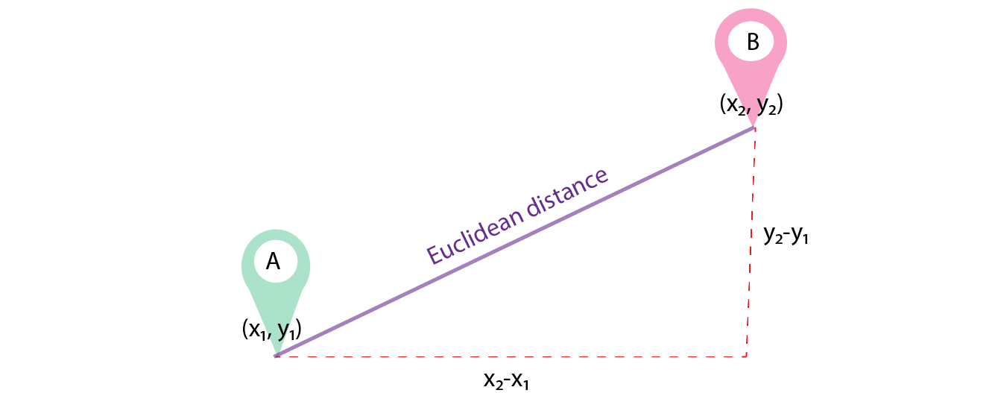
https://www.google.com/url?sa=i&url=https%3A%2F%2Fmedium.com%2Fanalytics-vidhya%2Frole-of-distance-metrics-in-machine-learning-e43391a6bf2e&psig=AOvVaw1uJ8fQ9n3MxOMEuJT6kj_B&ust=1614204656951000&source=images&cd=vfe&ved=0CA0QjhxqFwoTCIjk2JeDge8CFQAAAAAdAAAAABBm

Slide 46
Gene Y
Gene X
https://www.google.com/url?sa=i&url=https%3A%2F%2Fmedium.com%2Fanalytics-vidhya%2Frole-of-distance-metrics-in-machine-learning-e43391a6bf2e&psig=AOvVaw1uJ8fQ9n3MxOMEuJT6kj_B&ust=1614204656951000&source=images&cd=vfe&ved=0CA0QjhxqFwoTCIjk2JeDge8CFQAAAAAdAAAAABBm

Slide 47
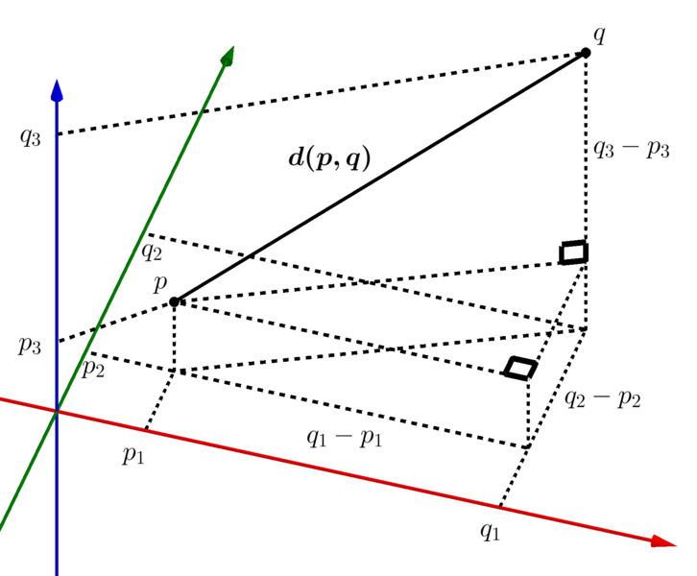
https://commons.wikimedia.org/wiki/File:Euclidean_distance_3d_1_cropped.png

Slide 48
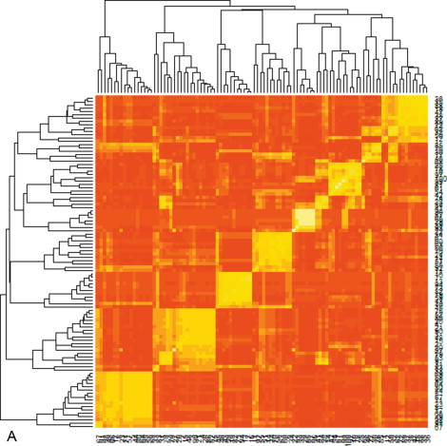
https://www.sciencedirect.com/topics/computer-science/similarity-matrix

Slide 49
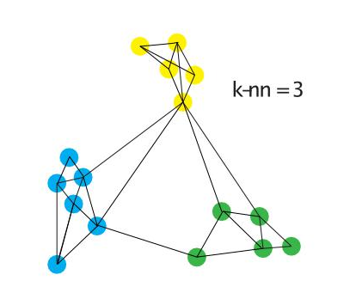
https://www.researchgate.net/figure/Example-of-graph-clustering-with-MCL-taken-from-vD00_fig5_265246092

Slide 50
Clustering and embedding from a neighbor graph

Slide 51
scRNA-Seq Downstream Analysis Workflow
Load Data
QC
Normalize & Scale
PCA & Nearest Neighbor Graph
Clustering
Advanced:
Cluster Marker Analysis
Cell Type Identification
Sub-clustering
Trajectories
Cell Cycle Analysis
Cluster DGE
Low Dimensional Embedding

Slide 52
https://www.researchgate.net/figure/Example-of-graph-clustering-with-MCL-taken-from-vD00_fig5_265246092

Slide 53
Graph Partitioning (e.g., Louvain Clustering)
https://www.researchgate.net/figure/Example-of-graph-clustering-with-MCL-taken-from-vD00_fig5_265246092

Slide 54
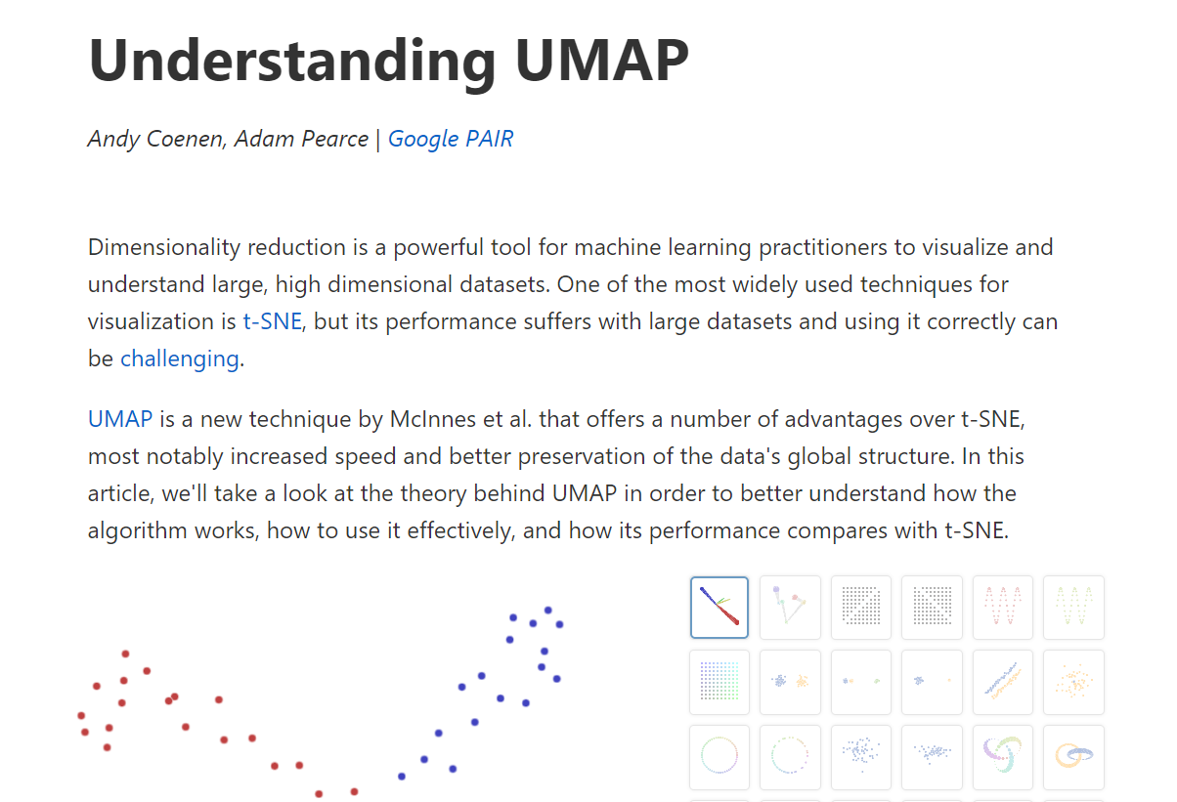
https://pair-code.github.io/understanding-umap/

Slide 55
scRNA-Seq Downstream Analysis Workflow
Load Data
QC
Normalize & Scale
PCA & Nearest Neighbor Graph
Clustering
Advanced:
Cluster Marker Analysis
Cell Type Identification
Sub-clustering
Trajectories
Cell Cycle Analysis
Cluster DGE
Low Dimensional Embedding

